Slide 1
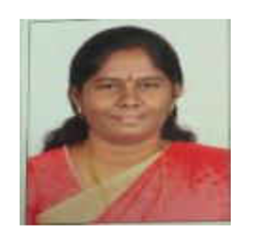





FOOD RE-DISTRIBUTION
C.M.NALAYINI
J.V.SANJAY
L.S.KIRRUTHIGA
R.RAKESH
R.MALINI SRI
S.SANTHOSH
Assistant Professor III
GUIDE
TEAM MEMBERS

Slide 2

ABSTRACT
The main objective of this project is to avoid food wastage and serve those who are suffering severely from hunger , lack of food ,poor orphanages etc.
We know that many food items are wasted during many events conducted around us, It may be a small event like birthday parties or a large function like marriage, etc. ,in large organizations like office , college , hotels etc. and on the other hand people are dying without getting food, we act as a platform between donors and poor recipients, unlike before methodologies in our project the work or donor is minimalized and food availability in each area is increased such that no people suffer from hunger.

Slide 3




PROBLEM
WE DON’T HAVE A PROPER SYSTEM TO REGULATE THE WASTAGE OF FOOD
194.4 million people i.e. 14.5% of our population is undernourished
India in terms of hunger rankings has slipped from 95th rank in 2010 to 102nd in 2019
They are depending on donations
They are not self sustaining i.e. always dependent
Malnutrition
Unavailability of food for needy
Food wastage
India Wastes Food Worth About $14 Billion A Year
Indians waste as much food as the whole of United Kingdom consumes”. In a nation like India where millions still sleep hungry on streets, it’s not a good statistic.
Ineffective systems
2nd largest producer of food
WFP says hunger kills more than AIDS, malaria, tuberculosis combined
3

Slide 4
LITERATURE SURVEY
Food donation: An initiative to mitigate hunger in the world
https://www.researchgate.net/publication/284726800_Food_donation_An_initiative_to_mitigate_hunger_in_the_world
Indians waste as much food as the whole of United Kingdom consumes”. In a nation like India where millions still sleep hungry on streets, it’s not a good statistic.
INDIA’S GLOBAL HUNGER INDEX
https://www.globalhungerindex.org/pdf/en/2019/India.pdf
India in terms of hunger rankings has slipped from 95th rank in 2010 to 102nd in 2019
Hunger in India | India FoodBanking Network
https://www.indiafoodbanking.org/hunger
Over 7000 Indians die of hunger every day.

Slide 5
Can India's hunger problem be tackled?
https://www.newindianexpress.com/business/2019/oct/20/we--thought-hunger-is-a-problem-of-the-past-2050159.html
In a country like india it is difficult to reach out to a nomad people who are in dire need of food and existing systems are trying their best but no desired results shows up
FOOD WASTAGE IN INDIA
https://www.chintan-india.org/sites/default/files/2019-09/Food%20waste%20in%20India.pdf
India wastes about 40 % of the food produced in an year
WORLD FOOD PROGRAMME
https://www.intechopen.com/books/perspective-of-recent-advances-in-acute-diarrhea/childhood-malnutrition-in-india#:~:text=India%20is%20home%20to%2046.6,addressing%20the%20issue%20of%20malnutrition.
WFP says hunger kills more than AIDS, malaria, tuberculosis combined
EXISTING SYSTEMS
https://www.riseagainsthungerindia.org/
https://foodtank.com
https://www.actionagainsthunger.org

Slide 6



EXSISTING DRAWBACKS
Limitations of existing systems
Transportation
Reachability
Volunteers
Expensive
In the existing system a transportation service has a major role and more man power ,petrol ,vehicles etc. were used which is highly expensive
The target persons of our projects are orphanage and those who are struggling for a meal , homeless and they are mostly nomads so becomes a hectic task for identifying them and serving them
In the existing systems we are involving volunteers and paid persons to serve the food to down-trodden people to make this system efficient we need a team or system for managing , and the other problem is that we can’t depend on volunteers all time
In the existing system you need to spent lot of money for transportation, , identification of needy persons etc.

Slide 7
PROPOSED SOLUTION
Better Logistics
Wider Network
Efficient Transportation
Identifying persons
The orphanage who are in need of food directly collect food by themselves
Instead of searching and identifying needy persons we are making them come to us
Facilitating donors & receivers
Simple to use
Facilitation
Enhanced user experience
Receiver can choose whatever food they want and how much ever they want by knowing the entire details of the food & donors no need to put an extra effort in donating the food
Maximum care is taken to improve the user experience of the application by incorporating needed & additional features

Slide 8
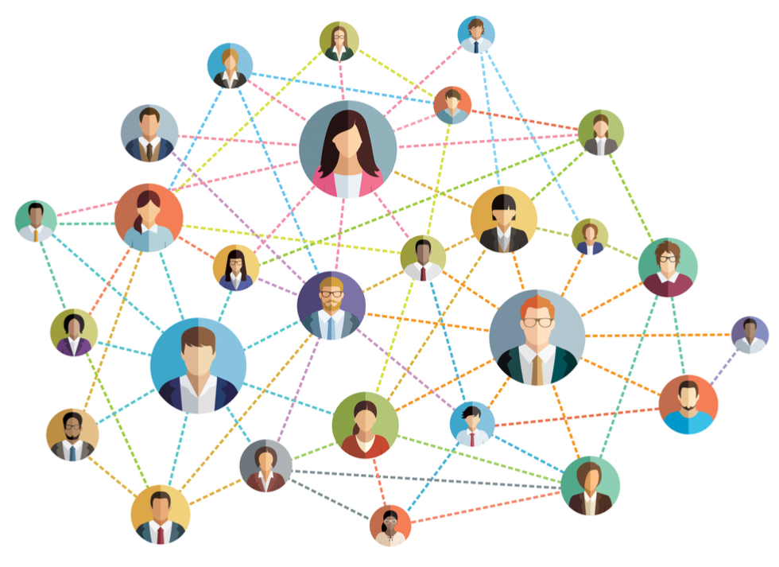
WIDER NETWORK
Since we increase the number of donors and receivers we will greatly reduce the loss of food
Larger population can be served easily
We have a separate login and signup for donors and receivers
Only the edible foods will be displayed so always the reliever can see the list of edible food details

Slide 9

Facilitating Donors & Receivers
Receiver can choose whatever food they want and how much ever they want by knowing the entire details of the food & donors no need to put an extra effort in donating the food
Countdown timer
Detailed info
Donors no need to take an extra effort in finding
Flexibility to add and delete food easily

Slide 10
Simple to use
Mail feature
Security
Error Message Displaying
Page Updation
Database Updation
Responsiveness
Easy Navigation
Visual Guide
Enhanced user experience by using multiple modules

Slide 11
MAIL FEATURE
Algorithms (or) Technique
Node mailer
We will receive mail On feedback submission
We will receive mail Once you confirm your orders (after getting the food that you want from the list of food available in receiver homepage), you will get a confirmatory mail stating that your orders has been confirmed
It uses SMTP protocol for mail transfers
Incorporated with node
Customized message sending
Send mail to multiple persons at a time

Slide 12
SECURITY
Algorithms (or) Technique
Hashing – 4/6 level of security
The donors homepage receivers homepage and my orders page can be accessed only after logging in(only the registered user can visit these pages).If a non-registered user tries to access this pages an error message will be displayed for them
While storing the user details password they entered is hashed and salted 10 times and stored in database which is 5th level security on the scale of 6 available in the market. Even if a hacker manages to crack into our database hacker can see only the hashed password.
Salting – 5/6 level of security
Top 10-12% companies have this level of security
Main page access only to registered users (post & get)

Slide 13
ERROR MESSAGE
Algorithms (or) Technique
EJS
While signing up a new account if the user tries to sign up with already registered username a message will be displayed in the screen stating that the user already exists.
While logging in if user wrongly enters password or username a message will be displayed in the screen stating invalid username or password
If a receiver tries to buy the food which was already brought by another receiver username a message will be displayed in the screen stating this food has already been ordered
Update information dynamically base on the message passed in post methods of node

Slide 14
PAGE UPDATION
Algorithms (or) Technique
JS EVENT HANDDLERS
The receiver’s home page automatically refreshes for every 2 minutes in order to remove the expired food and ordered food, and to display the list of newly donated food, so the user always see a list of available and new foods that are getting donated immediately
The my orders page is also refreshed for every 5 minutes so that the receiver can always see only the food that are edible and the expired food are automatically removed

Slide 15
DATABASE UPDATION
Algorithms (or) Technique
JAVASCRIPT TIMER METHODS
For every 24 hours the all the expired food data gets deleted from the database such that the database remains clean
For every 1 minute the food that are added to the cart are checked if it has exceeded 20 minutes time interval if exceeded it is removed from cart and added to general available list database.
For every 5 minutes my orders data are checked in database and expired foods are deleted from the database
Mongoose queries

Slide 16
RESPONSIVENESS
Algorithms (or) Technique
BOOTSTRAP(containers)
Our web application is built in such a way that it automatically detects screen sizes and adjust the contents accordingly ensuring the user a great visual experience in mobile sized screen, tab sized screen and pc or laptop sized screens.
CSS (media max width property-to adapt with the screen size)

Slide 17
EASY NAVIGATION
Algorithms (or) Technique
QUICK LINKS TO JUMP TO THE DESIRED LOCATION OF THE PAGE
To give the user an easy to use experience when you open the page login buttons are given high weightage so user can easy login immediately without scrolling or searching for login buttons(login function is the major function i.e user very rapidly than any other functionalities)
To guide a new user to register we have provided a link to register which will take them to the signup section where they can signup

Slide 18
VISUAL GUIDE
Algorithms (or) Technique
MAJORLY USED COMPONENTS AT THE TOP
In every page of our website we arranged the components based on their usage , i.e. most used components are placed in the beginning so that the user no need to scroll over and search.
LEAST USED COMPONENTS AT THE BOTTOM
FAQ SECTION WHEREVER NECESSARY

Slide 19

BETTER LOGISTICS
LOGISTICS PLAYS A MAJOR ROLE IN FOOD DISTRIBUTION
In our system we are going to cut the cost spend on logistics
The orphanages can directly communicate with the donors and no need of an middle man.
Since they directly communicate we no need to spend money on logistics & storage of food
Details of the food ordered are displayed in their individual logins for convenience

Slide 20
SCREENSHOTS

Slide 21
Main homepage

Slide 24
Signup-page

Slide 25
Login-page

Slide 26
Donor-Home Page

Slide 28
Receiver home-page

Slide 30
My orders – page

Slide 31
FUTURE WORKS

Slide 32
BUSINESS MODEL
In future we have plans to convert this into a business model by the following ways
1
2
3
NETWORK
MAN-POWER
MONEY-SOURCE
Initially this project targets to link every orphanage and big organizations through a social-media like interface i.e. through our website and this is done by associating them with . The target of this stage is to link every possible orphanages and organizations
Now we have almost every orphanages linked with us, now by converting this orphanages into sub-control systems and increasing the man-power i.e. by joining the starving people to this system and serving them food through orphanages as a common meeting point
Once we get food and man-power we can make them work for us and the work will be collecting the waste vegetables ,fruits etc. thrown is vegetable market and converting them into bio-fuels, methane, fertilizers etc. and selling them to get money and make this system a self-sustaining system

Slide 33
ZERO WASTAGE
THE MAJOR DOMAIN WE ARE CONCENTRATING IS ZERO WASTAGE OF FOOD ITEMS AND AN EFFICIENT USAGE OF IT
EDIBLE FOOD WASTE
BIO-DEGRADABLE WASTES
Did you know that about 40 % of the food produced in India is wasted?
Despite adequate food production, the UN has reported that about 190 million Indians remain undernourished.
The value of food wastage in India is around ₹92,000 crores per annum.
Approximately 84.7% of the total food waste recorded was thrown in the bin, while the rest was either fed to the poor or some animals
India is one of the largest agriculture based country, which cultivates large amount of fruits and vegetables. Out of this, 30 % of the fruits and vegetables grown in India get wasted annually
India, the world’s second largest producer of fruits and vegetables, is throwing away fresh produce worth Rs 13,300 crore every year
Food loss and waste generates about 8 per cent of global greenhouse gas emissions.
We all know that many food items like fruits and vegetables are just thrown away and polluting the environment

Slide 34
ADDITIONAL ADVANTAGES
1
Unemployment
By this system we could create new jobs for jobless in many sectors of this project
LETS DISCUSS SOME OF THE ADDITIONAL ADVANTAGES OF THIS PROJECT
2
Clean India
Actually we can clean many parts of India through this system and a better waste management can be done
3
Home For Homeless
Through this system we could construct permanent homes for homeless
4
Bio-Fertilizers
The organic wastes can efficiently be converted into Bio-fertilizers , Bio-fuels ,methane etc.

Slide 35
CONCLUSION
3
2
Self-Sustaining
1
Self-Sustaining System
Digitizing the existing methods of food for orphans and needy to make an easier and efficient than ever before & thus by solving a problem we are planning to start a business and develop India & earn profit out of it.by doing so we can achieve the following things
Cleaner India
By selling this organic waste items we could earn money
We could create organic fertilizers on our own and make profit out of it
Once we get enough man-power and money through above methods we could construct permanent shelters for home-less
No need to depend on donators completely .
Creating new jobs so avoiding unemployment
Swatch - Bharath
Food For All
In a country like India there are many markets
In each and every market around the country tons of edible waste items are just thrown on the street
These waste items thrown are just decomposed giving a foul smell and creating an unhygienic environment and polluting the surrounding
In our system our workers will collect this kinds of waste and clean the locality an initiative to swatch-Bharath
No wastage of food
The wastage of food can be avoided at a greater extent
The count of humans starving for food can be reduced drastically
Dropping hunger index and deaths due to lack of food
A better logistics
A better functioning of the system by gathering people together

Slide 36
Conference and publications
We are currently working on the part of publishing this as a paper in a journal

Slide 37
REFERENCES
https://foodsharesc.org/
http://site.foodshare.org/site/PageServer?pagename=index
www.riseagainsthungerindia.org
https://foodtank.com
https://www.actionagainsthunger.org
https://www.akshayapatra.org
https://thp.org
https://whyhunger.org
https://www.foodforthepoor.org
https://www.feedingindia.org

Slide 38
https://www.globalhungerindex.org/india.html#:~:text=In%20the%202019%20Global%20Hunger,See%2
0overview%20of%20GHI%20calculation%5D.
https://www.thehindu.com/news/national/global-hunger-index-2019-india-ranked-lower-than-nepalpakistan-
bangladesh/article29714429.ece
https://www.intechopen.com/books/perspective-of-recent-advances-in-acute-diarrhea/childhoodmalnutrition-
in-india
https://globalnutritionreport.org/resources/nutrition-profiles/asia/southern-asia/india/
https://timesofindia.indiatimes.com/india/india-falls-to-102-in-hunger-index-8-ranks-belowpakistan/
articleshow/71606116.cms
https://www.ibef.org/industry/agricultureindia.
aspx#:~:text=During%202019%2D20*%20crop%20year,grain%20production%20of%20298%20MT.
https://www.cleanindiajournal.com/food-wastage-crisis-in-india/
https://www.forbesindia.com/blog/technology/how-to-turn-indias-food-waste-problem-intoopportunity/

Slide 39

THANK YOU!
Velammal Engineering College
Organization Name:
Food Share
Website:
https://foodshareorg.herokuapp.com/

